Slide 1
WRF - FLEXPART simulations for Chacaltaya (CHC)
Diego Aliaga
Victoria Sinclair
Evgeny Kadantsev

Slide 2
Objectives
Understand the Meteorology at CHC
Create a dataset that quantifies the source area of air masses arriving at CHC with 1 hourly resolution.
Can be used to interpret measurements at CHC
Quantify the influence of La Paz on CHC
Quantify the influence of Sabancaya Volcano on CHC
Compare results to the previous analysis done with Hysplit

Slide 3
The Weather Research and Forecasting Model (WRF)
Mesoscale numerical weather prediction system
Community model developed and maintained by NCAR / NCEP
Use by researchers and as an operational forecast model
Updates released every ~6 months (current version is 4.0 released in June 2018)
Needs boundary / initial conditions from a global model / reanalysis
Eulerian model (fixed grid)

Slide 4
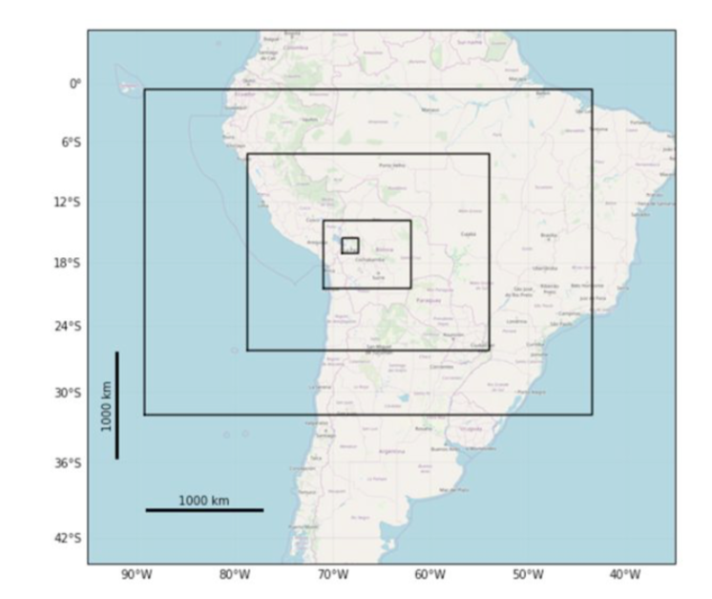
Nested domains
WRF can be run with multiple nested domains
“Dynamical downscaling”
The inner domains are smaller and have smaller grid spacing than the outer domains.
Need to “step down” gradually from reanalysis resolution.
Here we use 4 nests: grid spacing 36 km, 9 km, 3 km, 1 km

Slide 5
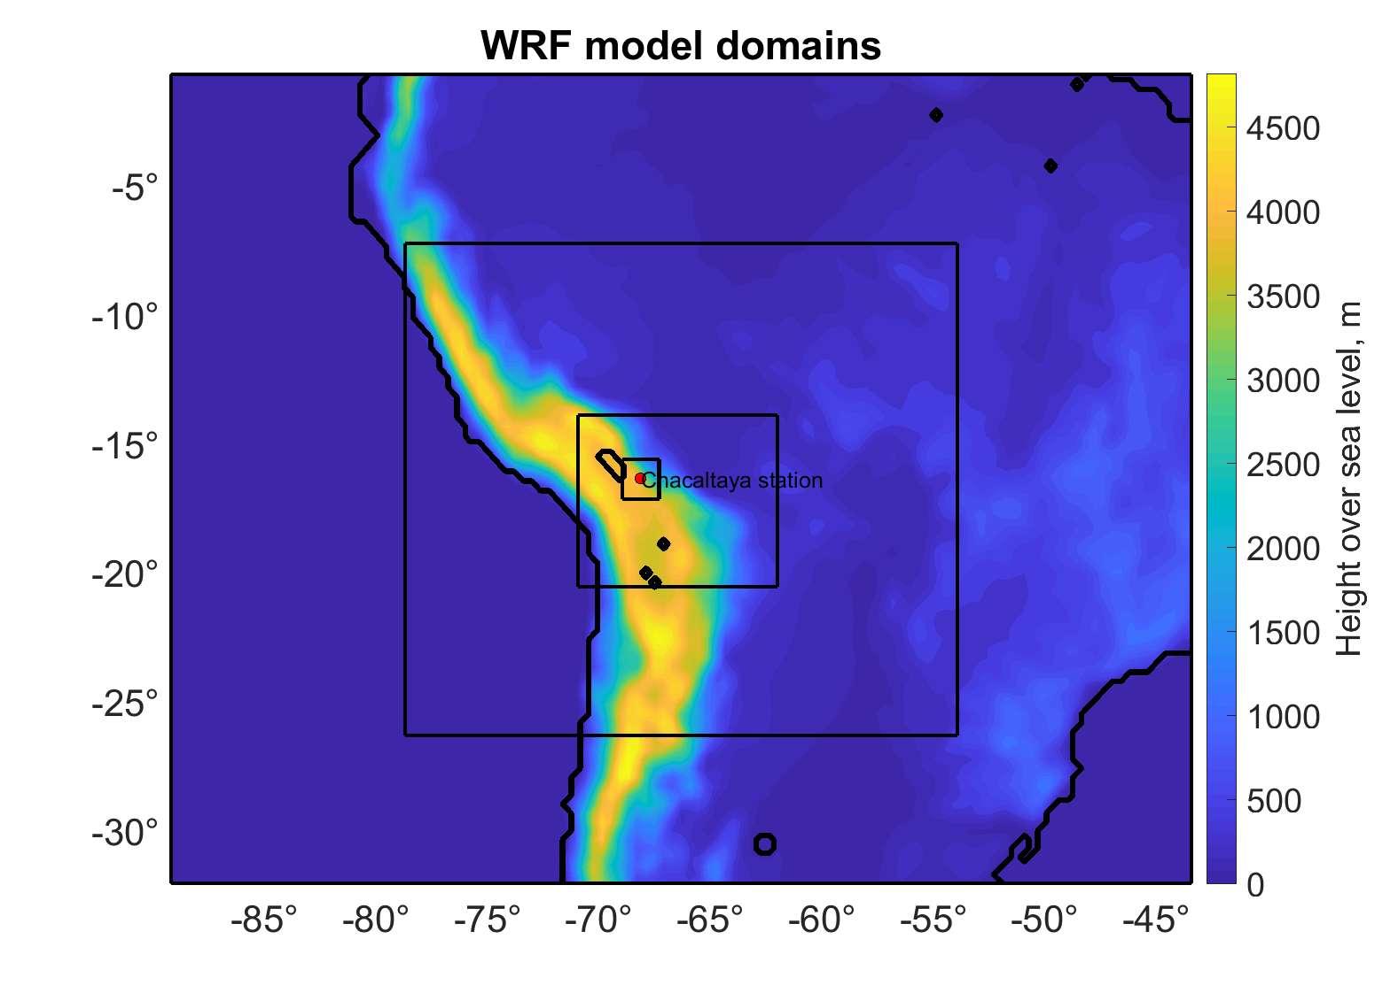
Nested domains
WRF can be run with multiple nested domains
“Dynamical downscaling”
The inner domains are smaller and have smaller grid spacing than the outer domains.
Need to “step down” gradually from reanalysis resolution.
Here we use 4 nests: grid spacing 36 km, 9 km, 3 km, 1 km

Slide 6
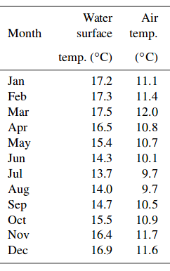
Lake temperature problems
WRF can be set up in many different ways
Need to carefully configure the model and check the results are sensible
We discovered that the surface temperature of Lake Titicaca was much colder (10°C) in the model than in reality
Major problem - causes the wrong stability of the boundary layer above the lake
Fixed by forcing the model lake temperature to be the same as the monthly mean observations
Pillco Zolá et al., 2019: Modelling Lake Titicaca's daily and monthly evaporation

Slide 7
FLEXPART
Lagrangian Dispersion model
Can be used in forward or backward mode
Calculates the position of thousands of particles as a function of time
Gives an estimate of uncertainty / variability
Can also do simple trajectories
Temporal and spatial resolution of the input / driving meteorological data is critical.
If the input data is at 50 km grid spacing and every 6 hours, FLEXPART can only resolve large-scale features and will not capture winds driven by topography.

Slide 8
Method taken here
Run a 6 month WRF simulation
To keep it close to reality, we use “nudging” of the outer domain
Impact of nuding was studied
Output variables in all 4 domains, inner domain data is output most often - every 10 minutes.
Use the WRF output as input to FLEXPART
Do backward simulations every hour from Chacaltaya
Release height is 10 m
Release 20 000 particles
Particles advected backwards for 96 hours (4 days)

Slide 9
Computational Issues and Current Status
The WRF simulations are computation expensive
CSC computers are very busy / full so jobs need to queue
Lots of additional meteorological information will be available though
boundary layer depth, surface fluxes, temperature and wind vertical profiles
Can be used for many other studies
Currently 3 months of WRF simulations are complete
FLEXPART simulations are cheaper to run but need to wait until the WRF simulations are ready
Currently 3 month FLEXPART simulations are ready.
Preliminary results based on 3 months are now presented

Slide 10
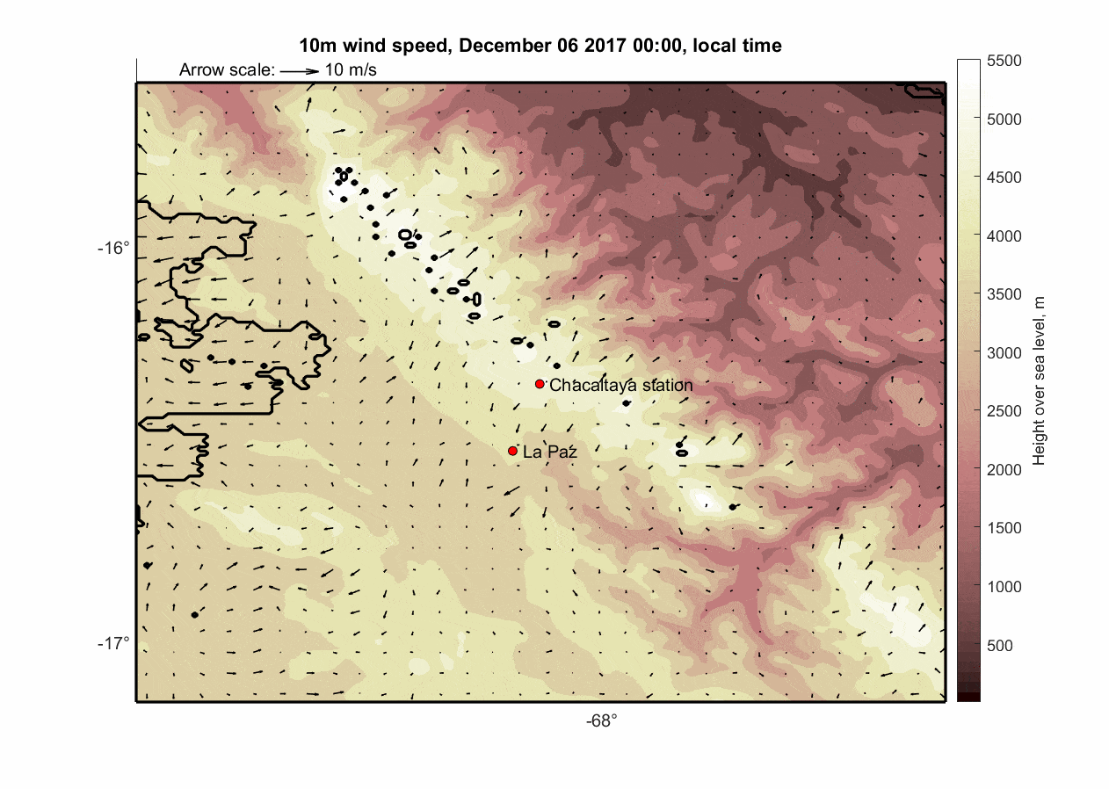
WRF output example: 10-m wind speed (vectors)
Lake Titicaca

Slide 11
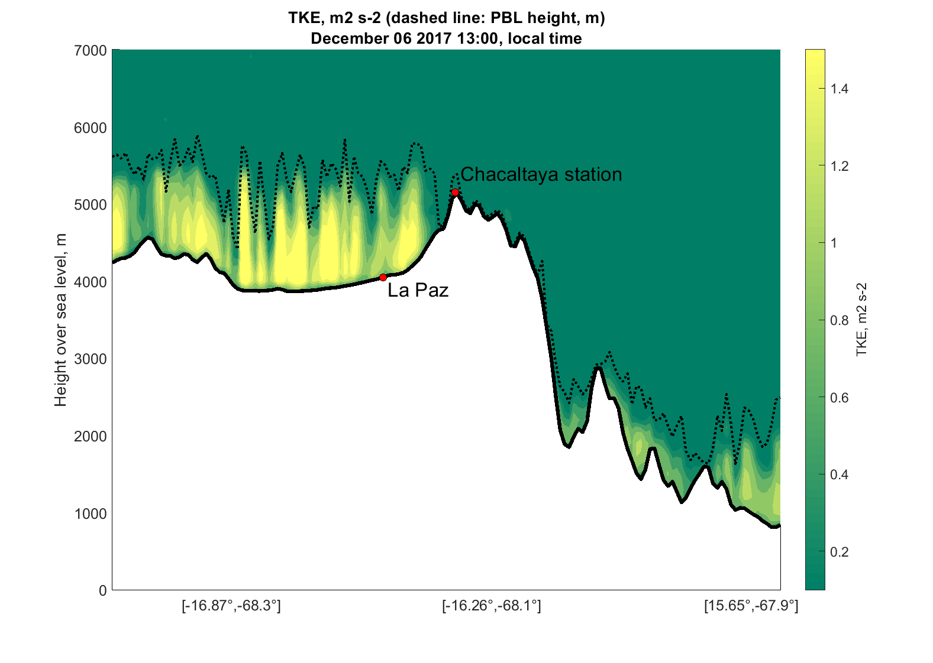
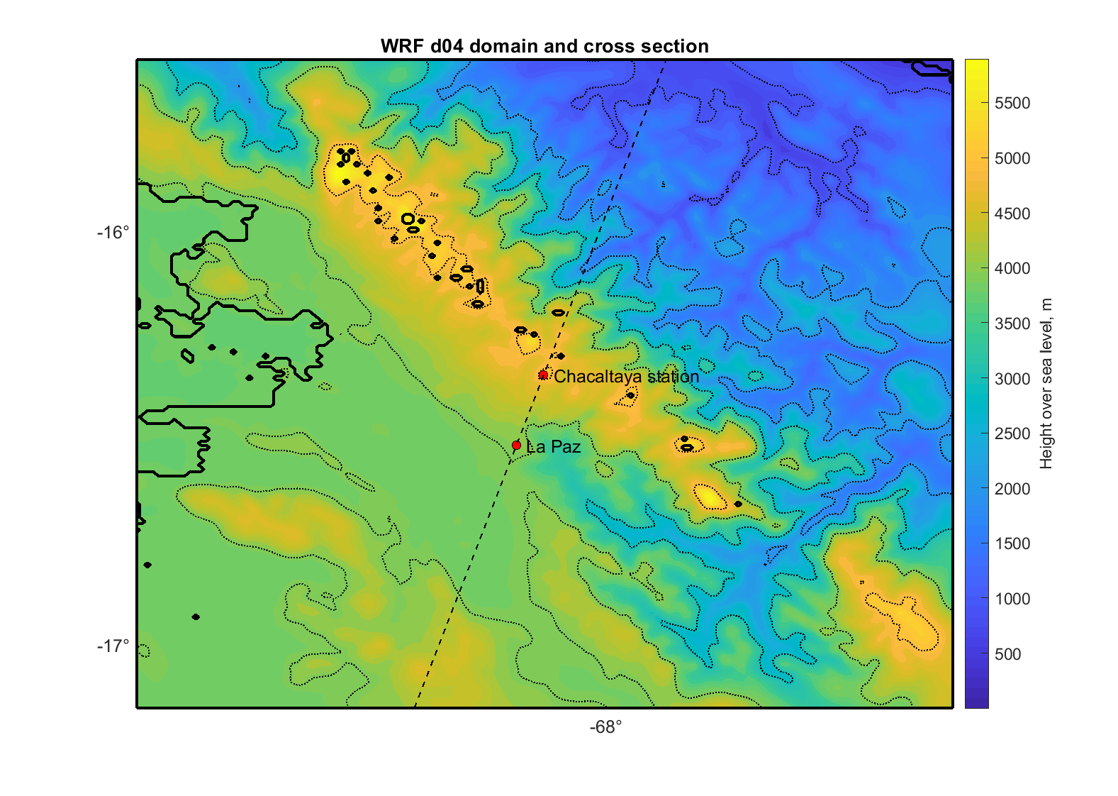
Example of WRF output: Turbulent Kinetic Energy (TKE) and BL depth
Cross section of TKE and BL depth from La Paz to Chacaltaya.

Slide 12
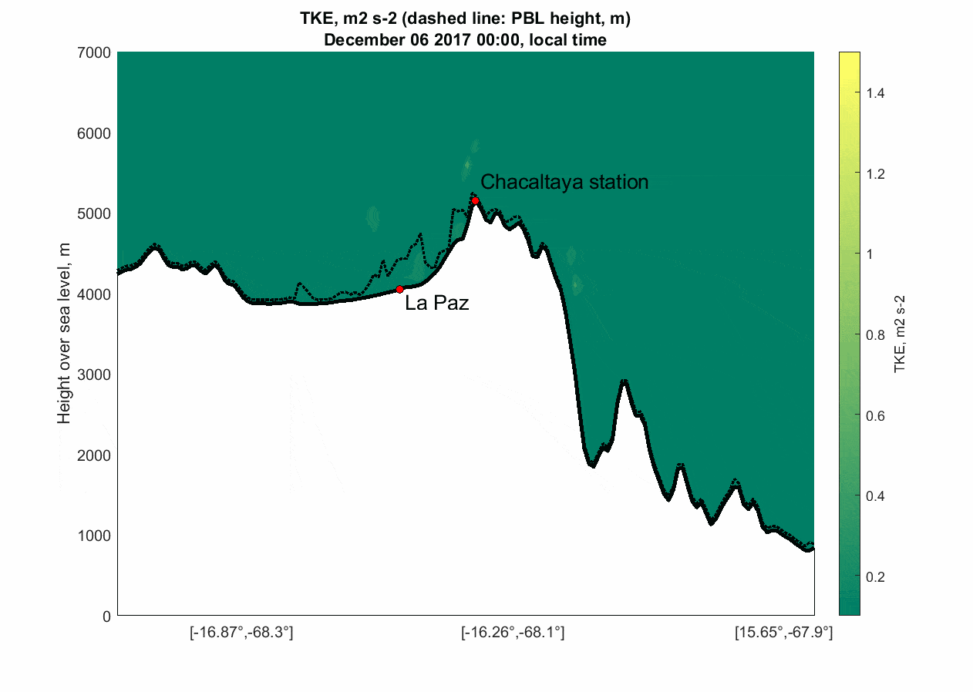
Example of WRF output: Turbulent Kinetic Energy (TKE) and BL depth

Slide 13
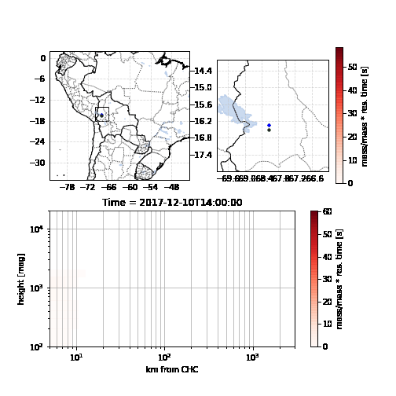
FLEXPART output - one example from one release
96 hour backward run starting at CHC.
Lower Center: height above ground [m]
Logarithmic scale!

Slide 14
Planned diagnostics to share with others
Animations of particles spreading out look really nice but are not easy to quantify, use in other studies
Plan to use a similar analysis method to that used before with Hysplit trajectories
Interpolate FLEXPART to a polar grid centered on CHC
Use the 96 hour integrated response time
Apply automated clustering
Once the 6 month analysis is done. Final clusters areas + time series of influence will be shared.
Special case studies can also be done for particular time periods.

Slide 15
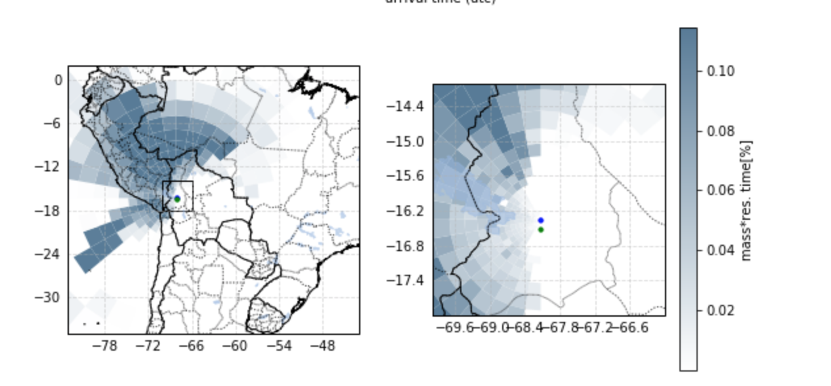
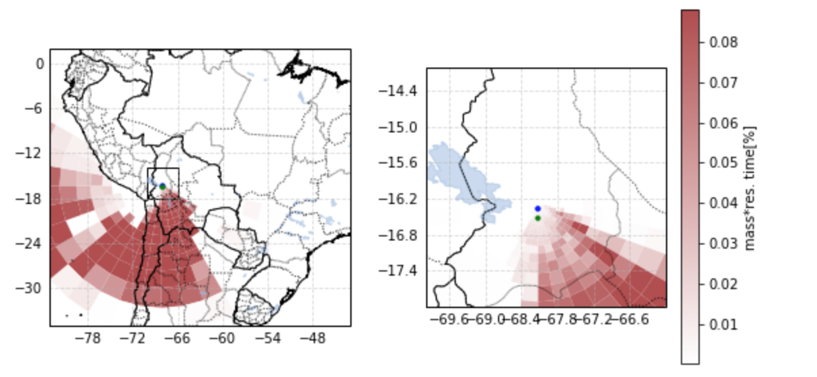
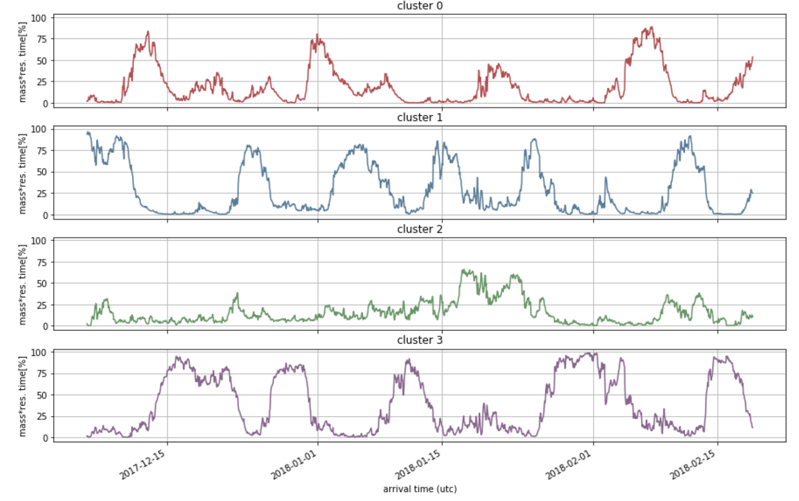
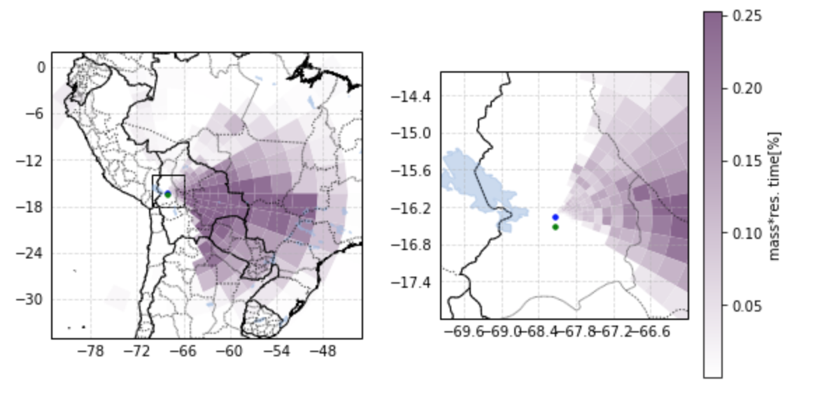
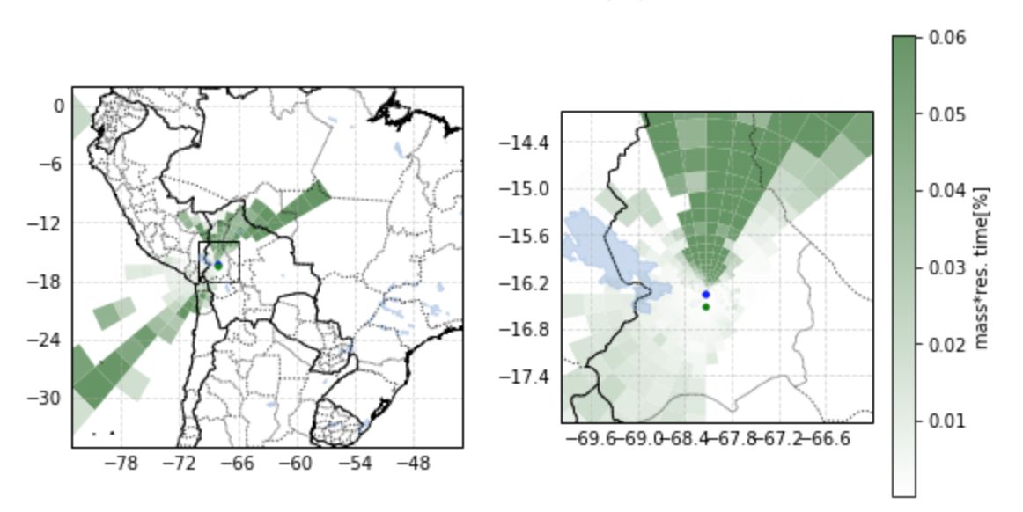
Clustering Analysis on FLEXPART output
Note different colour scales on the right
General picture:
4 clusters
More info at: https://github.com/daliagachc/flexpart_management/blob/master/flexpart_management/notebooks/run_2019-06-10_11-10-03_/flex_output_4%20clusters.ipynb

Slide 16
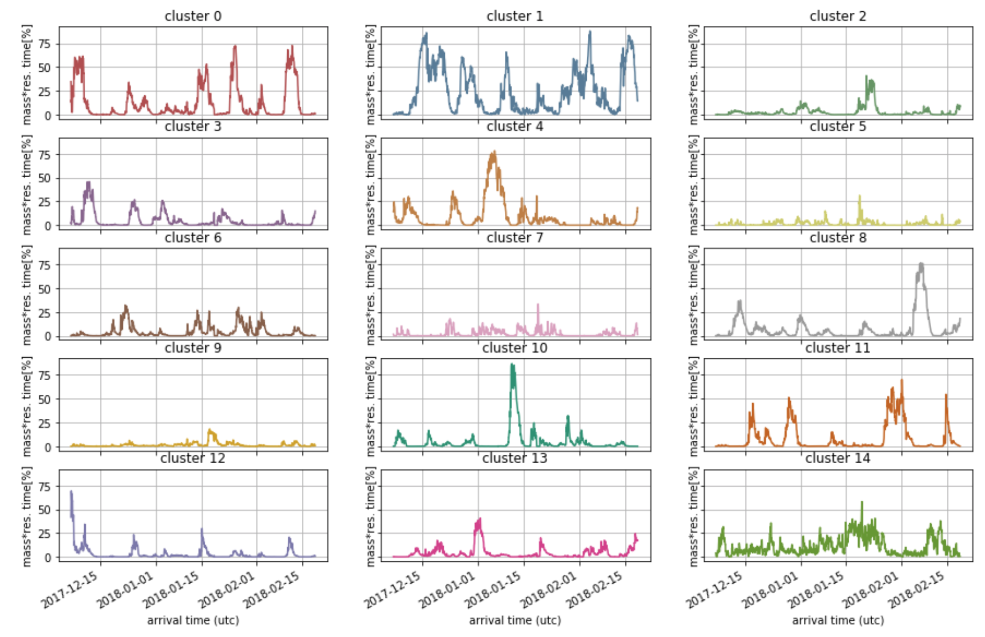
Clustering Analysis on FLEXPART output
Detailed picture:
15 clusters
More info at: https://github.com/daliagachc/flexpart_management/blob/master/flexpart_management/notebooks/run_2019-06-10_11-10-03_/flex_output_15_clusters.ipynb

Slide 17
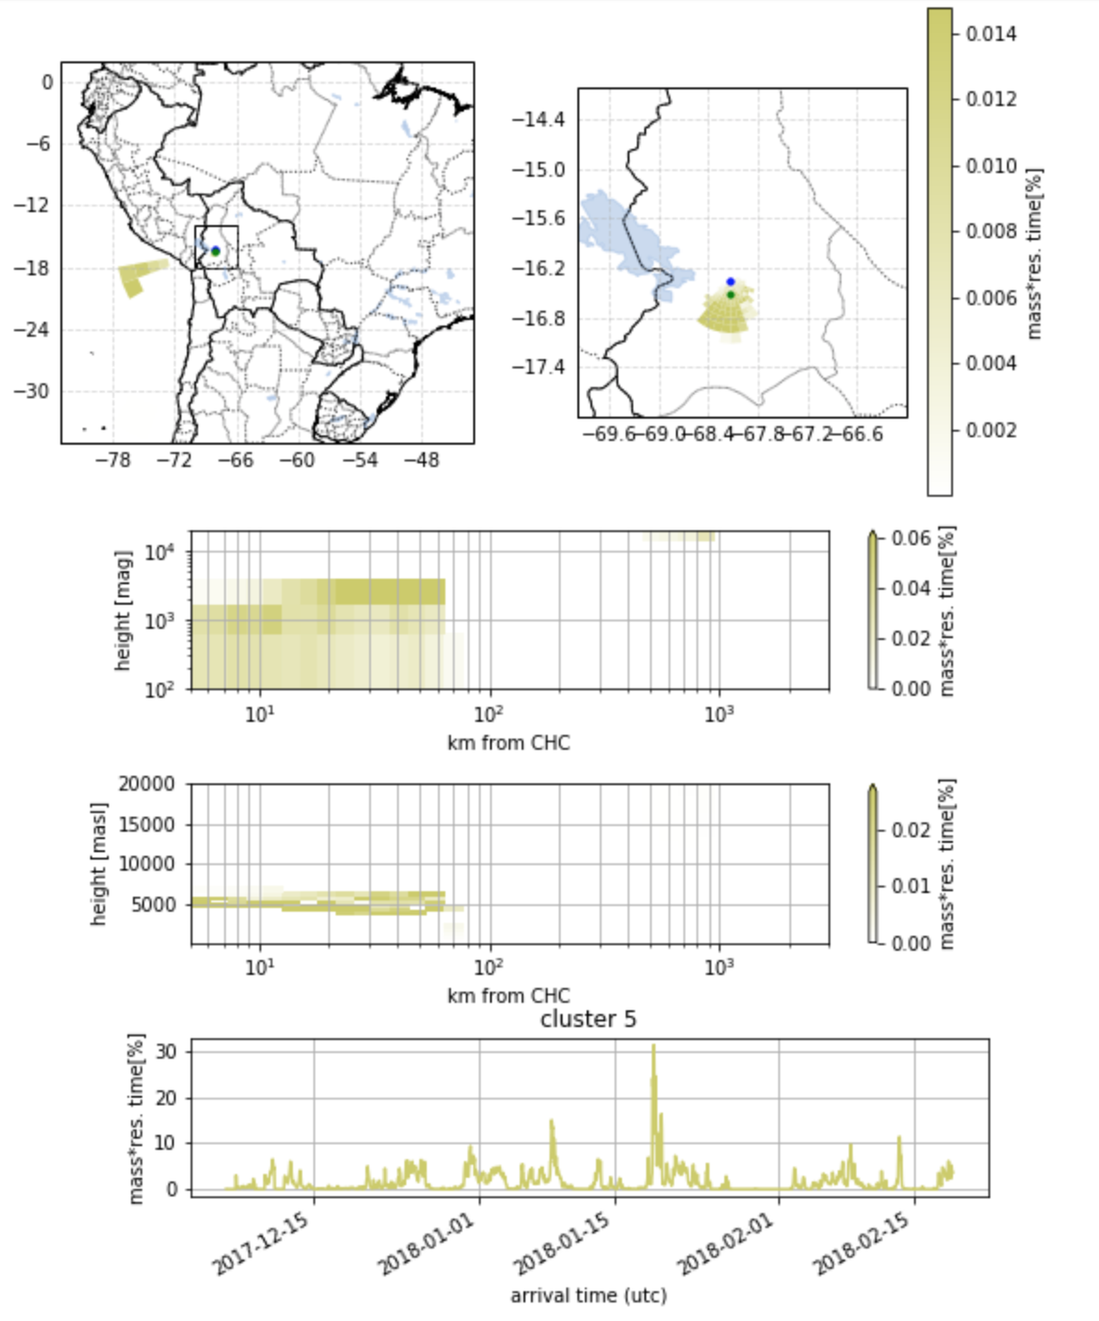
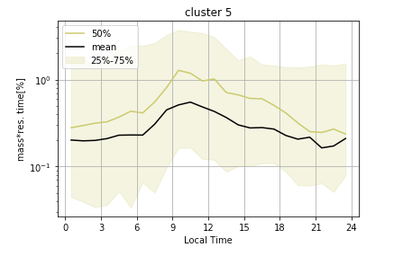
Clustering Analysis on FLEXPART output
La Paz Cluster (from 15 clusters)
More info at: https://github.com/daliagachc/flexpart_management/blob/master/flexpart_management/notebooks/run_2019-06-10_11-10-03_/lapaz_cluster_15.ipynb

Slide 18
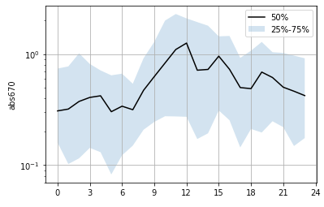
Clustering Analysis on FLEXPART output
Comparison abs670 at CHC (~bc from MAAP) to La Paz Cluster
Double peak in BC due to rush hour in La Paz
More info at: https://github.com/daliagachc/flexpart_management/blob/master/flexpart_management/notebooks/run_2019-06-10_11-10-03_/lapaz_cluster_15.ipynb

Slide 19
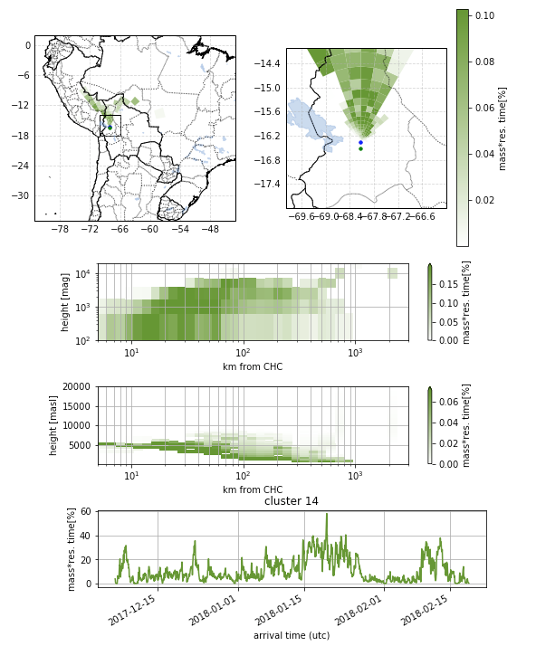
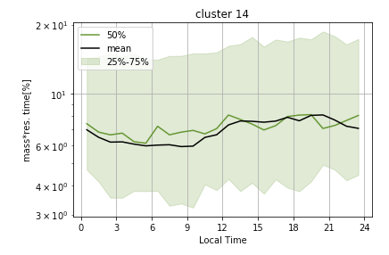
Clustering Analysis on FLEXPART output
Low Lands North Cluster (from 15 clusters)
More info at: https://github.com/daliagachc/flexpart_management/blob/master/flexpart_management/notebooks/run_2019-06-10_11-10-03_/lapaz_cluster_15.ipynb

Slide 20
Preliminary Conclusions
The WRF simulations now provide a reliable estimate of the meteorology
Not perfect, some biases at night in stable conditions.
The clustering method is effective at reducing the huge data volumes to a user friendly data set.
Air arriving at Chacaltaya arrives from all sectors during the 3 month period.
Diurnal pattern of air masses arriving from La Paz is resolved and resembles measurements of black carbon.

Slide 21
Some Comments
Results are preliminary - 3 months is a relatively short time.
Data available now via github (see links) can be used for initial analysis but you will need to repeat the analysis in ~1 month with the final data set
Response function from FLEXPART will be available every hour
Contains much more detailed information
Useful for case studies.
Specific requests for “unique” / specialised data should be directed to Diego via github (add an issue)

Slide 22
Future plans
Clustering needs to be repeated once all WRF simulations are complete
WRF simulations will finishing running in ~10 days
FLEXPART simulations + cluster analysis expected to take ~20 days.
Distribute final data set to others when it is ready
Start preparing a manuscript which
Describes the methodology, diagnostics and data set.
Quantifies where air masses arriving at CHC originate from in a horizontal and vertical sense
Assesses correlations between source regions and local wind direction
Publish the data set / obtain a DOI for the data so it can be cited correctly.

Slide 23
Paper aim
Quantify the source regions of air arriving at CHC using both meteorological and surface type clusters and ascertain the relative contribution of boundary layer, shallow convection layer and free tropopshere air.
Quantify the source regions of air arriving at CHC using surface type clusters and ascertain the relative contribution of boundary layer, shallow convection layer and free tropopshere air. Identify the large-scale synoptic conditions associated with each of these clusters.
Link synoptic patterns to the geographical clusters.
Role of shifting Hadley Cell, ITCZ

Slide 24
Thank you

Slide 25
Example of WRF output
Cross section of TKE and BL depth from La Paz to Chacaltaya + map of location. + static plot of TKE from one time when the PBL is deep
TKE = turbulent kinetic energy
.

